Slide 1
Data Science Fundamentals
Shahriar’s Analytical Academy

Slide 2
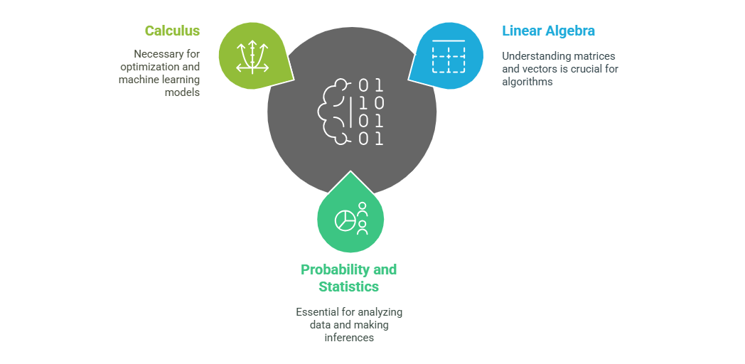
Mathematics for Data Science
Notes:
Mathematics and statistics form the foundation of data science, enabling professionals to effectively analyze and interpret data.
Linear Algebra is key to understanding data structures like matrices and vectors, which are fundamental in many algorithms, especially in machine learning and deep learning. Operations such as dot products help in transforming data, performing calculations, and making predictions in models like neural networks.
Probability and Statistics are essential for drawing conclusions from data. A solid understanding of probability helps assess the likelihood of certain events, while knowledge of distributions, such as the normal distribution, helps understand the spread and patterns in data. Hypothesis testing and statistical methods allow data scientists to make inferences about populations based on sample data, testing theories or models.
Calculus is necessary for solving optimization problems, which are common in data science. Understanding derivatives and integrals is especially useful in machine learning models, such as when applying gradient descent. This technique is used to minimize error in predictions by adjusting model parameters incrementally.

Slide 3
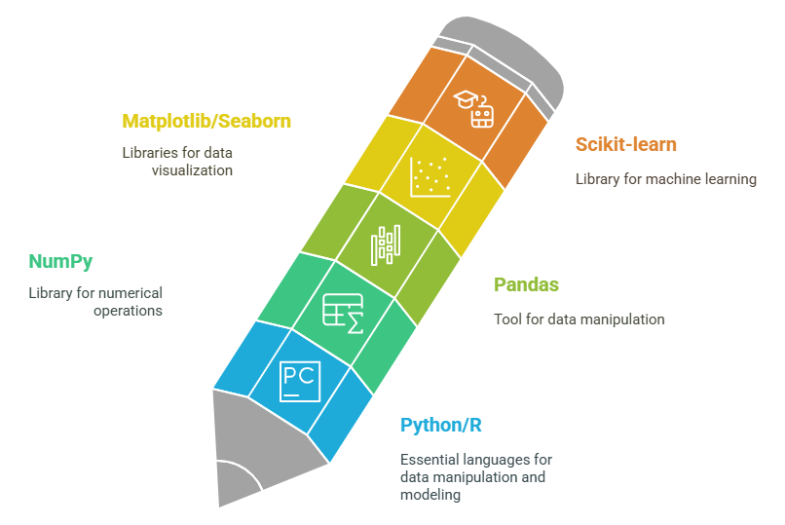
Programming Languages & Tools
Notes:
Python is the most widely used programming language in data science due to its simplicity and versatility. It is especially effective for writing scripts to manipulate data, build machine learning models, and visualize results. R is another popular language, particularly in academic and research settings, but Python tends to be the go-to choice for most data scientists. Mastering Python or R is essential for any data science work.
To maximize the power of these languages, it's important to become familiar with essential libraries and tools. For Python, NumPy is used for numerical operations, allowing you to perform complex mathematical calculations efficiently. Pandas is key for data manipulation, helping to clean, transform, and analyze large datasets. Matplotlib and Seaborn are powerful libraries for data visualization, enabling you to create a variety of graphs and plots to present your findings. Lastly, Scikit-learn is widely used for building machine learning models, offering a range of algorithms for classification, regression, and clustering tasks. Familiarity with these libraries is crucial for performing various data science tasks efficiently.

Slide 4
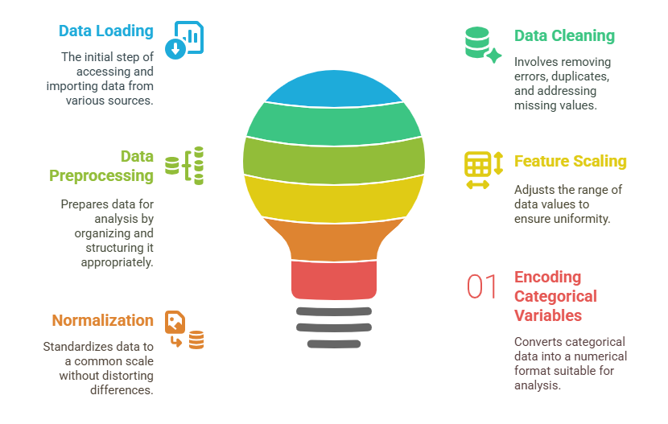
Data Manipulation & Cleaning
Notes:
Data Manipulation and Cleaning are crucial steps in any data science project, as real-world data is often messy and requires careful preparation before analysis.
Handling Data involves the process of loading, cleaning, and preprocessing raw data. Real-world datasets often contain issues like missing values, duplicates, and outliers, which need to be addressed to ensure the data is accurate and reliable. For example, missing values can be filled with mean, median, or mode, or rows with missing data can be removed. Duplicates can be identified and removed to avoid bias, and outliers can be handled through techniques such as trimming or transformation to prevent them from skewing results.
Data Transformation involves converting the data into a format that is suitable for analysis and modeling. This might include feature scaling (e.g., normalizing or standardizing values so they’re on a similar scale), which is important when working with machine learning models that are sensitive to the magnitude of data (like distance-based models). Normalization ensures that data falls within a specific range, while encoding categorical variables transforms non-numeric data (like text labels) into numerical format, allowing models to process the data effectively. These steps make data more structured and ready for analysis, improving the overall performance of machine learning algorithms.

Slide 5
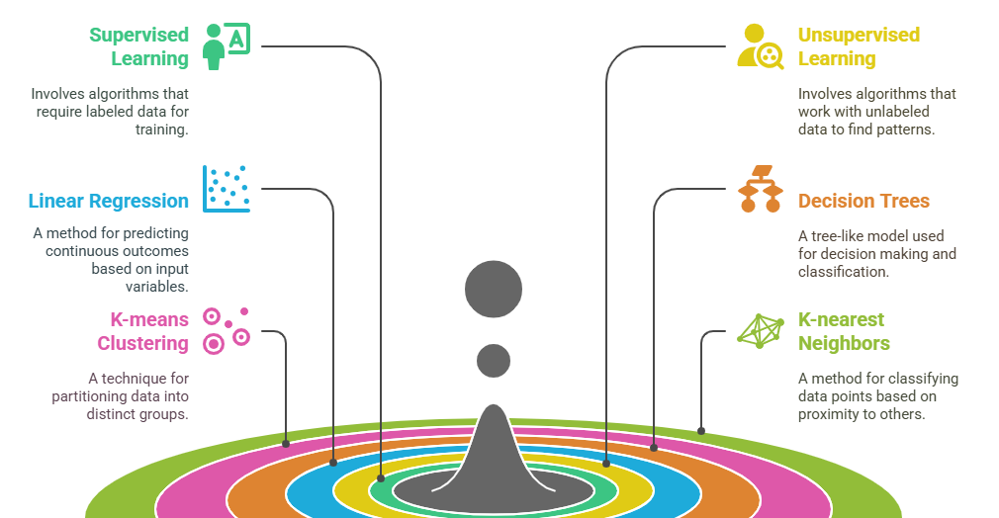
Machine Learning Models
Notes:
Supervised vs Unsupervised Learning is a key distinction in machine learning. In supervised learning, the algorithm is trained on labeled data, meaning the input data is paired with the correct output (or label). The goal is for the model to learn the mapping from input to output so that it can predict the labels of new, unseen data. Common examples include classification (e.g., spam email detection) and regression (e.g., predicting house prices). In unsupervised learning, the algorithm works with unlabeled data and tries to find hidden patterns or structures in the data, such as clustering or grouping similar items. This type of learning is often used for tasks like customer segmentation or anomaly detection.
Algorithms are the core methods used to build machine learning models. Some of the most fundamental algorithms include:
Linear Regression: A simple algorithm used to model the relationship between a dependent variable and one or more independent variables. It's often used for predicting continuous values, such as sales or temperature.
Decision Trees: A tree-like model used for classification and regression tasks. It splits the data into subsets based on the most significant features, making decisions at each node.
K-Means Clustering: An unsupervised learning algorithm that groups data into clusters based on similarity. It’s widely used in customer segmentation and pattern recognition.
K-Nearest Neighbors (KNN): A simple, instance-based learning algorithm used for classification and regression. It assigns a label to a data point based on the majority label of its k-nearest neighbors.
In the upcoming lessons, you will master all these things for real-life use cases.

Slide 6
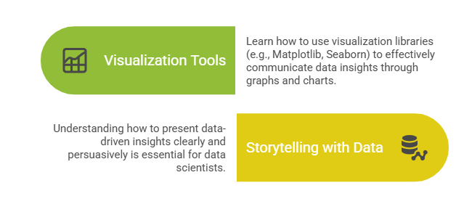
Data Visualization for Communication
Notes:
Data Visualization plays a crucial role in communicating the findings from data analysis. It helps present complex data in a way that is easy to understand and actionable.
Visualization Tools are essential for creating clear and informative graphs and charts. Libraries like Matplotlib and Seaborn in Python are commonly used for data visualization. Matplotlib provides flexibility for creating a wide range of visualizations, from simple line charts to more complex plots. Seaborn builds on Matplotlib and simplifies the process of creating visually appealing and insightful statistical plots. Learning to use these tools effectively enables data scientists to illustrate trends, distributions, relationships, and comparisons within datasets, making it easier for others to understand the data.
Storytelling with Data is the ability to present data-driven insights in a compelling and clear way. A good data story involves more than just showing graphs; it requires understanding the context, highlighting the most important findings, and presenting them in a way that resonates with the audience.

Slide 7
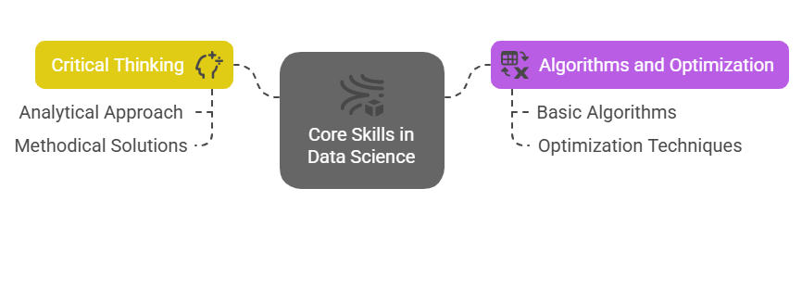
Problem-Solving and Analytical Thinking
Notes:
Problem-Solving and Analytical Thinking are essential skills for data scientists, as they help to approach complex problems logically and efficiently.
Critical Thinking is key to approaching problems analytically. It involves breaking down a problem into smaller, more manageable components and examining each part to understand the underlying issue. By thinking methodically, you can consider all possible solutions and assess their feasibility. This structured approach helps identify the best way to solve problems and make decisions, ensuring that the analysis is thorough and accurate.
Algorithms and Optimization are crucial in data science because they help process and analyze large datasets efficiently. Algorithms are step-by-step instructions or rules used to solve specific problems, such as sorting data, finding patterns, or predicting outcomes. Understanding basic algorithms helps in selecting the right one for a given problem. Optimization refers to techniques used to make algorithms run more efficiently, improving their performance in terms of speed, accuracy, or resource usage. In data science, optimization is often necessary when dealing with big data or computationally complex models, as it ensures that resources are used effectively and that solutions are found quickly.

Slide 8
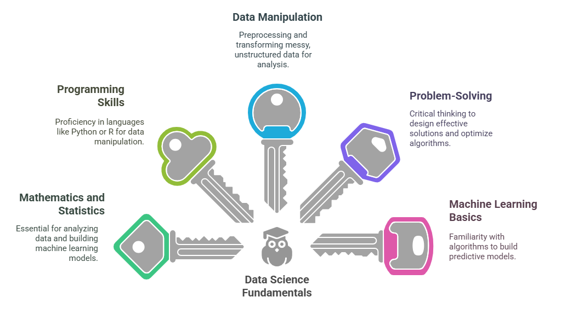
5 key learning points of this lesson
Notes:
In this lesson the key things we have learnt that A solid understanding of linear algebra, probability, statistics, and calculus is essential for analyzing data and building machine learning models. These mathematical concepts provide the foundation for understanding algorithms and optimizing model performance.
Proficiency in programming languages like Python or R, and knowledge of essential libraries such as Pandas, NumPy, and Scikit-learn, are crucial for data manipulation and model building. These tools enable data scientists to process data, create models, and generate meaningful insights efficiently.
Learning how to preprocess, clean, and transform data is crucial because real-world data is often messy and unstructured. This step ensures that data is in a usable format for analysis and modeling, which is vital for obtaining accurate results.
Developing critical thinking and problem-solving skills is key to breaking down complex data problems, designing effective solutions, and optimizing algorithms. These skills help data scientists approach challenges methodically and make informed decisions during the analysis process.
Familiarizing yourself with fundamental machine learning concepts and algorithms, such as supervised and unsupervised learning, helps in building predictive models. Understanding these techniques allows data scientists to choose the right algorithms and apply them effectively for tasks like classification, regression, and clustering.
4o

Slide 9
Thank You!
Shahriar’s Analytical Academy

